Slide 1



Center for Africana Studies
Recognizing the humanity in all

Slide 2

What is the Center for Africana Studies?
Location of the African Studies Program that is part of International Studies
Location of the Archaeology Laboratory for African and African Diaspora Studies directed by Dr. Warren Perry and Ms. Janet Woodruff
A gathering place for students to support their sense of belonging and academic performance while at CCSU
Home of the New Britain African American Oral History Project

Slide 3
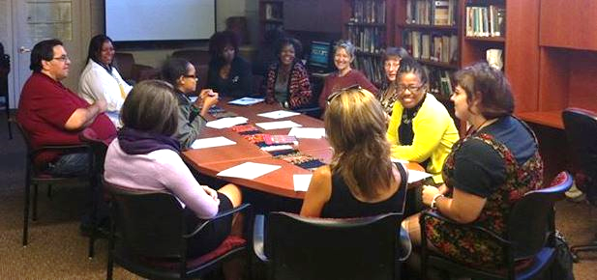
Physical Location
The Center for Africana Studies is located at 008 Marcus White Hall
Next to the computer lab in the basement, below the Psychology Department and next to Bassett Hall

Slide 4
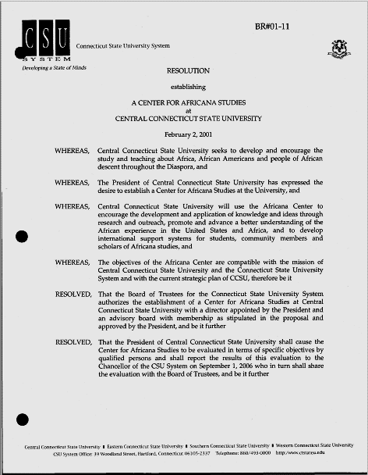
Beginning
The Center for Africana Studies was established in 2001 by a resolution from the Chancellor of the then CSC system.
The Center opened in 2003 in the lower level of Marcus White Hall.
We will have a reopening October 15, 2019, Marcus White 008. Drumming begins at 4 p.m. and program begins at 4:30.
Every five years we report our achievement to the BOR. We have been renewed each request.

Slide 5
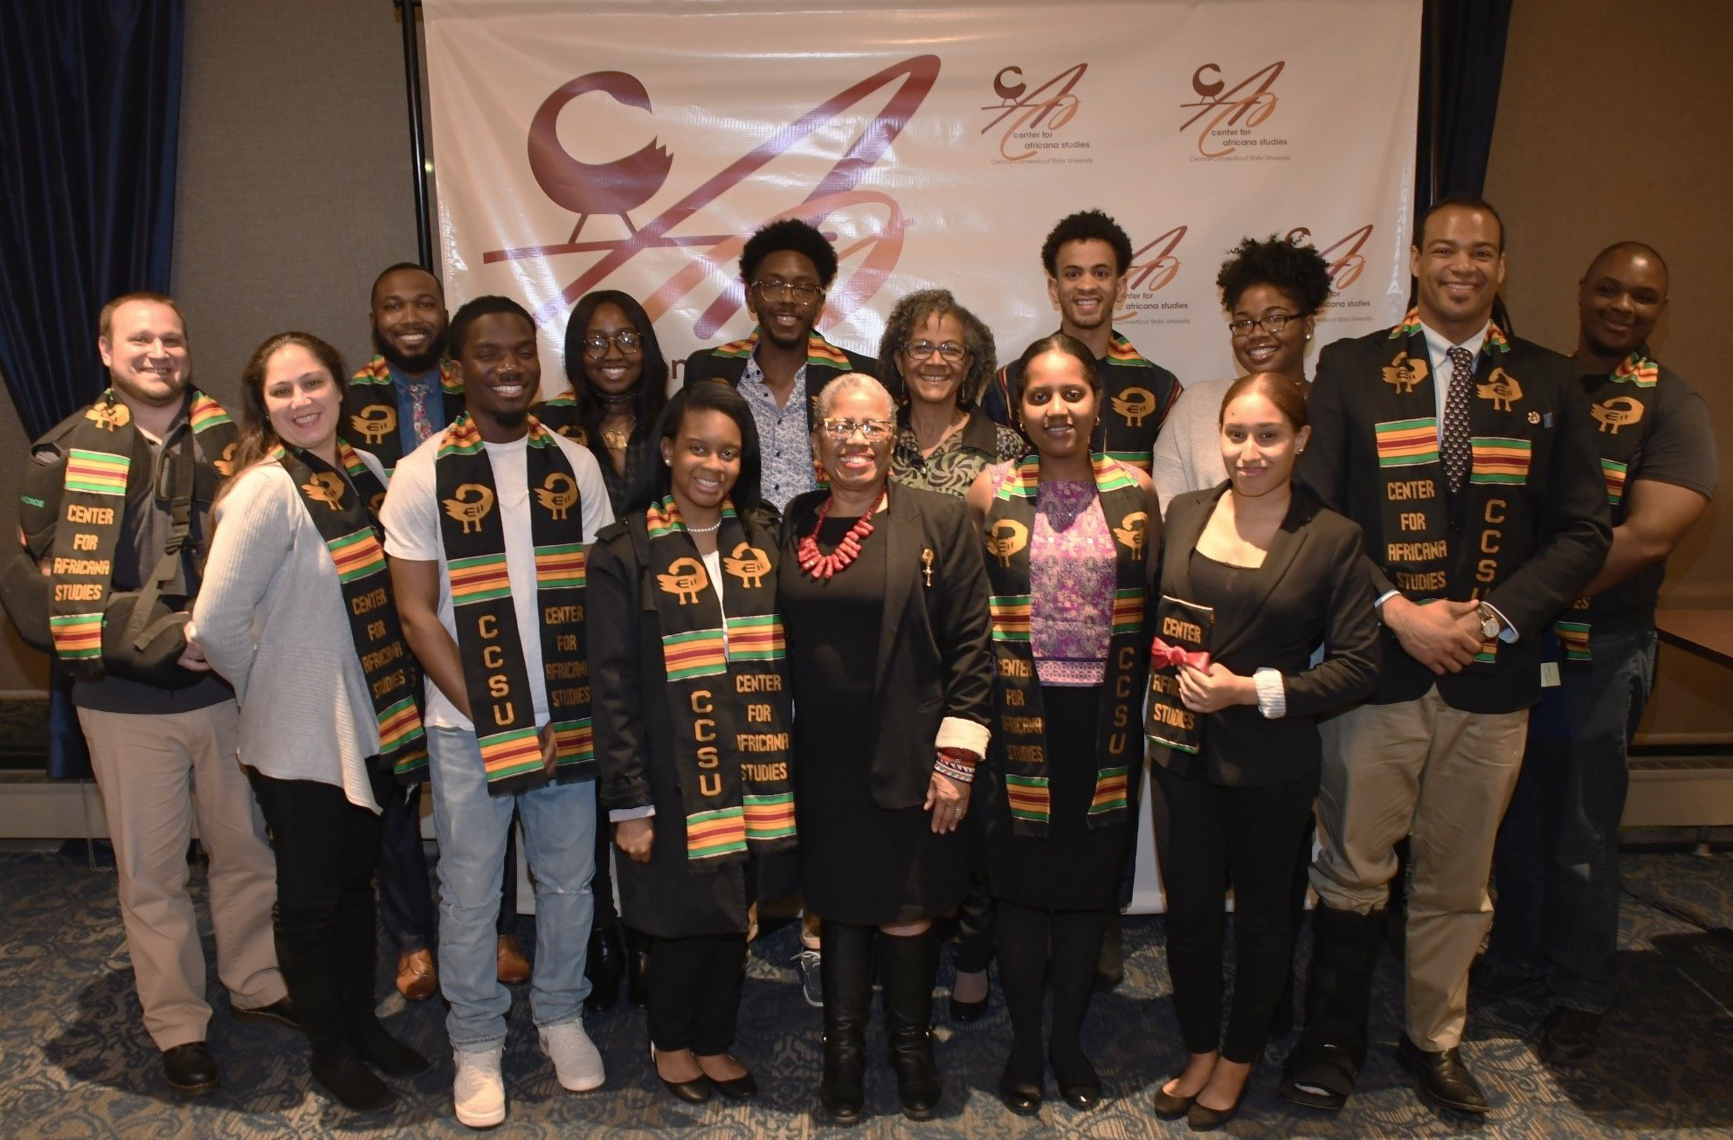
Mission
To develop and encourage the study and teaching about Africa and people of African descent throughout the world.
To promote and advance a better understanding of Africa and its peoples.
To promote research, consultation and community service among CCSU faculty, students, scholars and community members.

Slide 6
How do we achieve these goals?
Provide annual internships to 10 students to empower them as scholars and community members who are grounded in a knowledge of Africa and self actualization
Provide internship for social work graduate interns
Host an Annual Conference that includes international scholars who address a theme – First Thursday in March
Support the Amistad Lectures
New Britain African American Oral History Project
Study Abroad; Field School in Archaeology through Anthropology
Trips to museums, such as the African Burial Ground
Workshops on writing, study techniques, career planning, and more

Slide 7
What we do

Slide 8

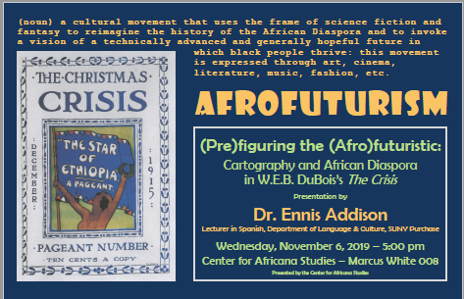


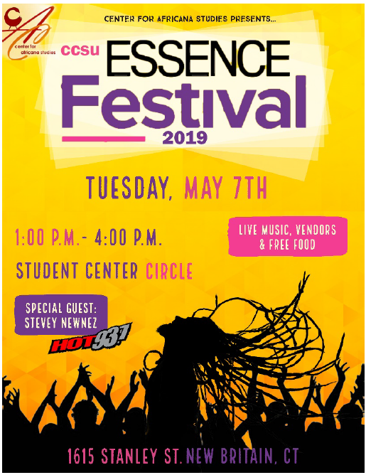
Programs and events

Slide 9
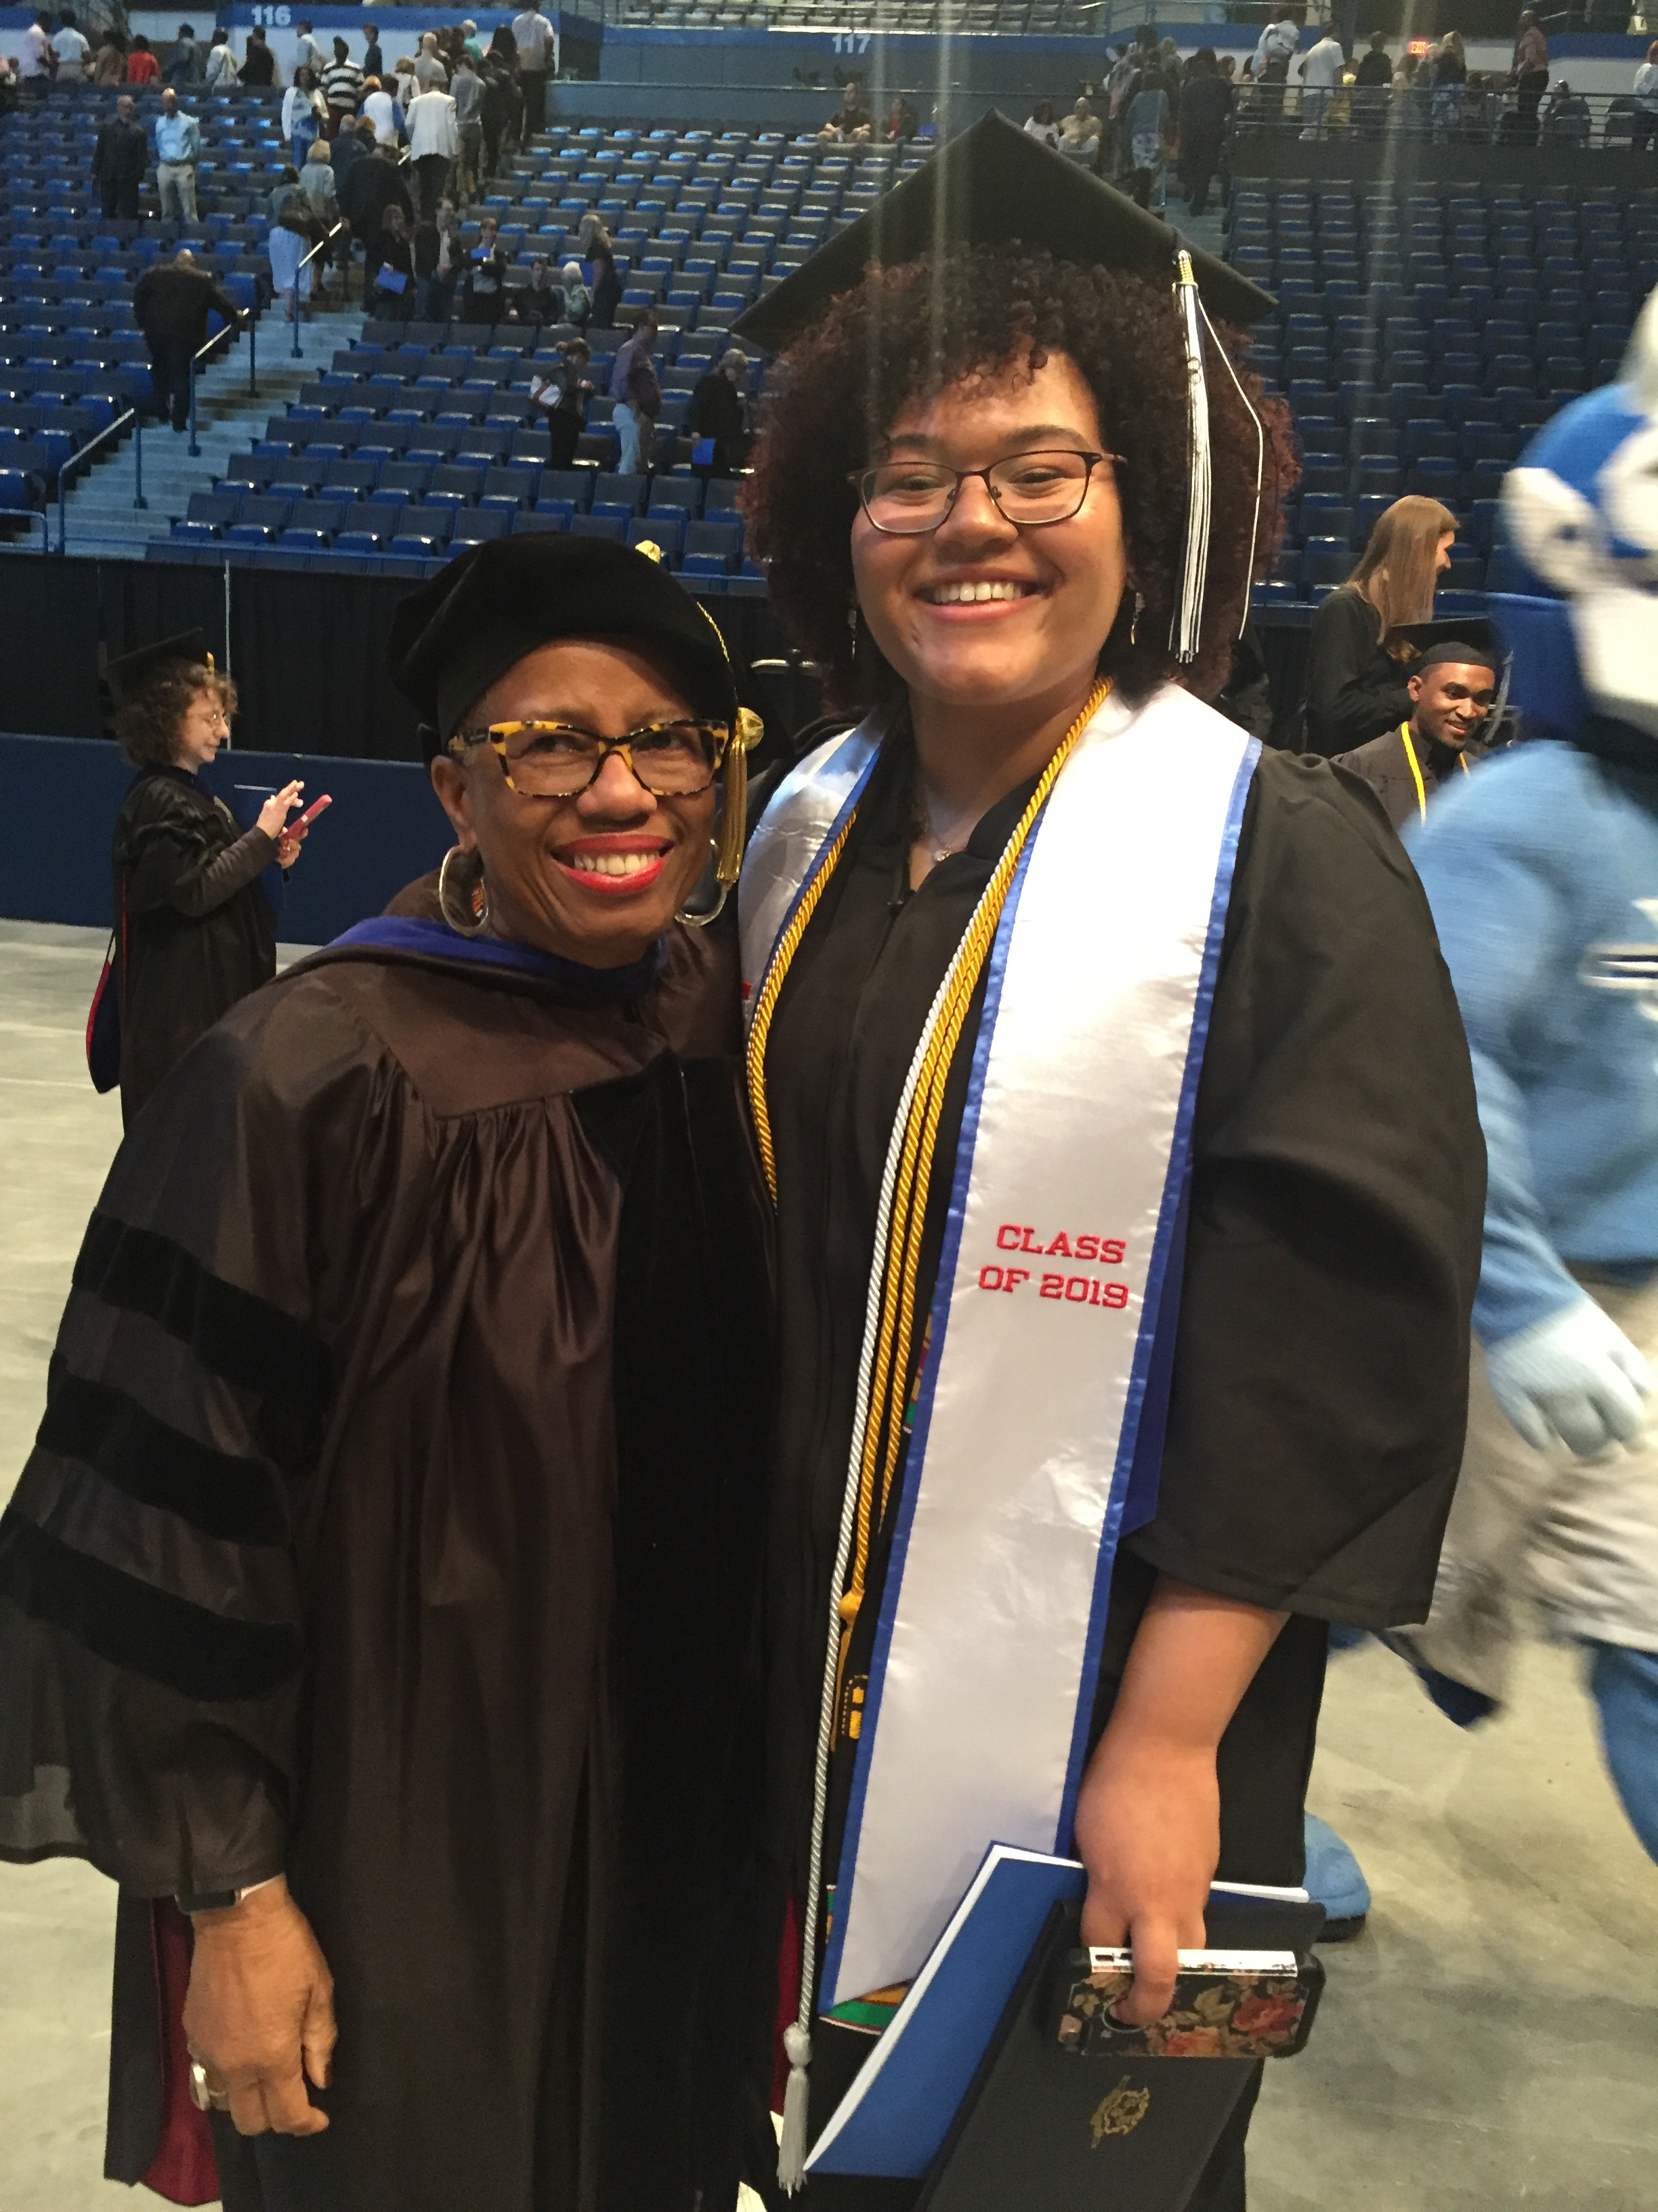
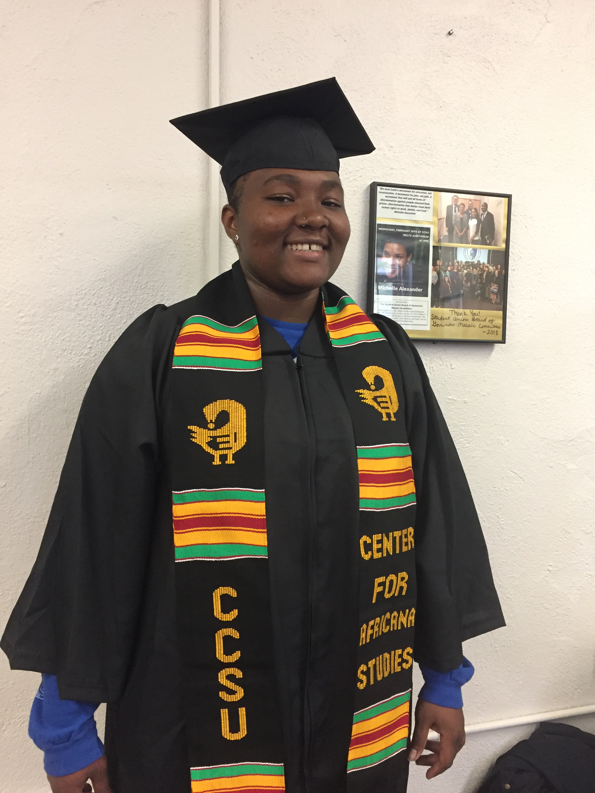
Graduation

Slide 10
Rationale
Prior to the1960s, Black and Latinx students were invisible on the CCSU campus.
The students’ activism led to the creation of the African American Studies program.
Studies show that students of color face both overt and covert racism in PWIs.
Structurally, most curriculums are taught from a Western perspective. African, Asian, Latin and Middle Eastern cultures are excluded from the discourse except in courses that address these specific cultures.
Despite their demonstrated effectiveness in creating an inclusive and respectful campus climate, diversity requirements are the exception rather than the rule.

Slide 11
Challenges
Inclusion in university matters that affect students and faculty of color
Economic support for students
Increased enrollment of students of color but the Center budget has not kept pace

